Slide 1
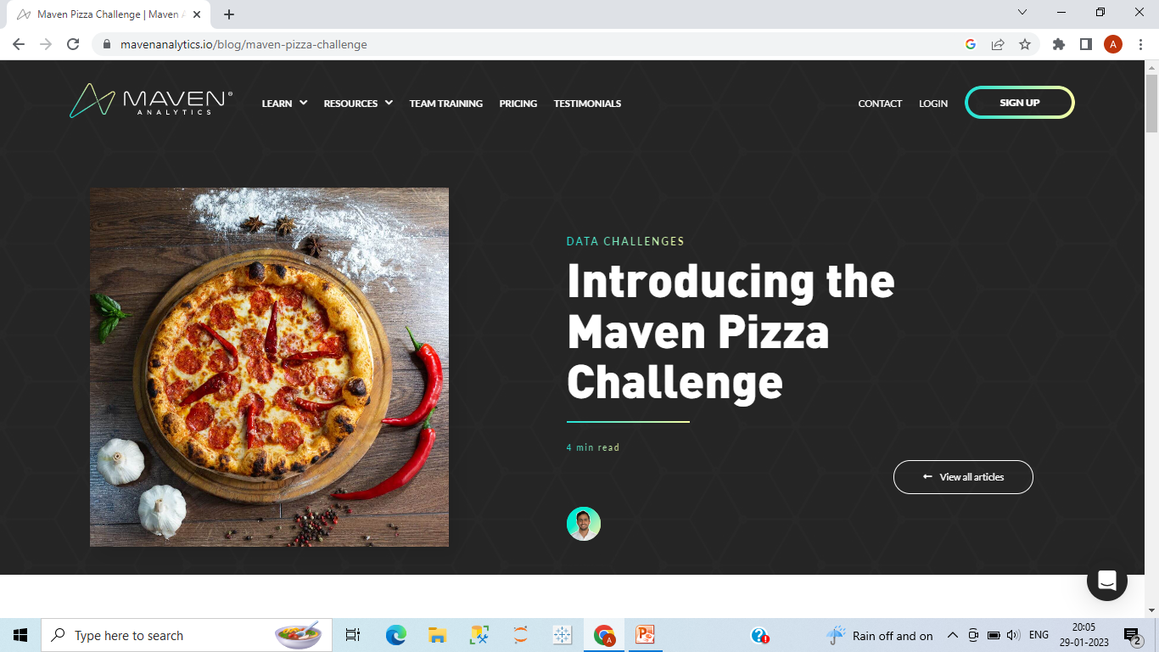
Maven Pizza Challenge
By:- Ashish Rana
BI Consultant
Notes:
We designed this template so that each member of the project team has a set of slides with its own theme. Members, here’s how you add a new slide to just your set:
Mark where you want to add the slide: Select an existing one in the Thumbnails pane, click the New Slide button, then choose a layout. The new slide gets the same theme as the other slides in your set.
Careful! Don’t annoy your fellow presenters by accidentally changing their themes. That can happen if you choose a different theme from the Design tab, which changes all of the slides in the presentation to that look.

Slide 2
About Maven Pizza Challenge
For the Maven Pizza Challenge, you’ll be playing the role of a BI Consultant hired by Plato's Pizza, a Greek-inspired pizza place in New Jersey. You've been hired to help the restaurant use data to improve operations.

Slide 3
About the dataset
This dataset contains 4 tables in CSV format
The Orders table contains the date & time that all table orders were placed
The Order Details table contains the different pizzas served with each order in the Orders table, and their quantities
The Pizzas table contains the size and price for each distinct pizza in the Order Details table, as well as its broader pizza type
The Pizza Types table contains details on the pizza types in the Pizzas table, including their name as it appears on the menu, the category it falls under, and its list of ingredients

Slide 4
Procedure/Methodology
For this project Ist I done the EDA by python to to analyze & clean the Data.
After that Used Tableau for visualization & unlock insights.

Slide 5
Insights
• Peak Hours are 12:00, 13:00 in the afternoon and 17:00 to 19:00 in the evening.
• Friday accounted for the highest total order 3538 and was 34.83% higher than Sunday which had the lowest Total orders at 2624.
• Classic accounted for 29.99% of Total Orders and 26.91% of Total Revenue.
• Large size pizzas have the highest number of Orders (38.10%) of the Total Orders followed by Medium size pizzas (31.64%)
• July had the highest Total Revenue and was 13.32% higher than October, which had the lowest Total Revenue.
• Large size pizza accounted for 45.89% of Total Revenue and ﻿Classic had the highest Total Revenue.
• Our Table capacity and Seating Capacity is high on Peak hours and on somedays also exceeds our Total Table Capacity of 15 mostly on peak timings.

Slide 6
Recommendations
• The Brie Carre pizza can be excluded from the menu as it is the least selling pizza and also the least revenue generating pizza.
• XXL has the least number of Orders with only 28 Pizzas sold annually. So, we can also exclude XXL pizzas from menu.
• Introduce 2 seated tables to efficiently utilize our seating capacity and to earn higher revenue.

Slide 7
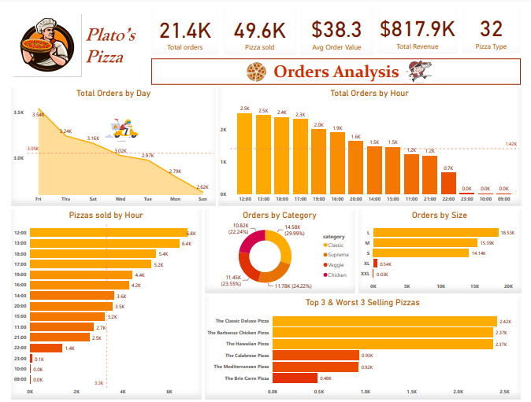

Slide 8
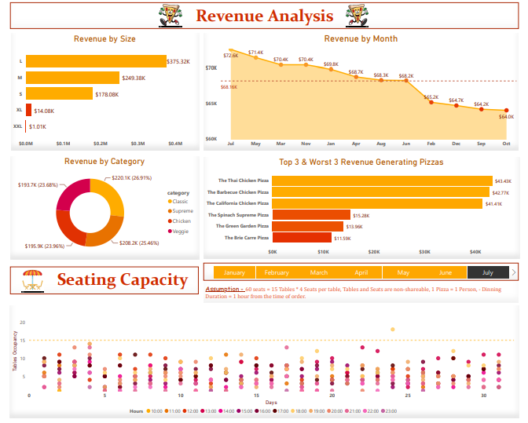

Slide 9
Thanks….

